Slide 1
Chapter 4:
Design Principles I: Correctness and Robustness

Slide 2
Objectives
To introduce two design principles
  Correctness
  Robustness

Slide 3
Correctness
Software design must satisfy the requirements for the application
The more specific a question, the more precisely we can verify the correctness of a design that answers it
Precise and imprecise questions:
  What number adds to 3 to get 5?
  What bridge design gets cars from point A to point B?
Correctness of design usually means sufficient design

Slide 4
Approaches to Correctness
How can we know that a design is correct or even sufficient?
Informal approaches
  To be convinced that the design covers the required functionality.
Formal approaches
  Involve applying mathematical logic to analyzing the way in which the variables change
  Usually applied when the design enters the detailed stage

Slide 5
Informal Approaches to Correctness
Based on the common sense idea that before we can proclaimed a design to be correct, we have to understand it completely.
Informal approaches require that design must be
  Readable (to enhance understanding)
  Modular (to deal with complexity)

Slide 6
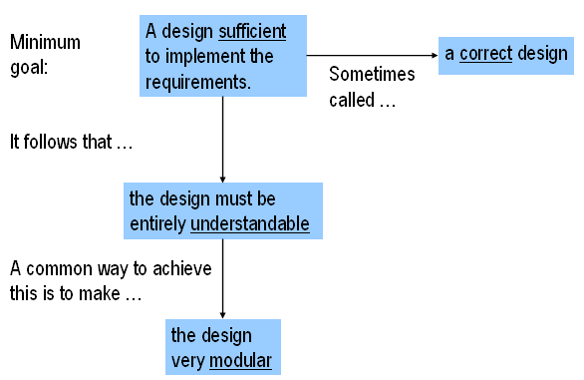
Sufficient Designs:
Terminology and Rationale

Slide 7
Key Concept: Correctness by Informal Methods
Simplify and modularize designs until they are convincing.
A famous apology (Pascal & Shaw): “I didn’t have time to write a short letter, so I wrote a long one”

Slide 8
Formal Approaches to Correctness
Keeping variable changes under tight control
It can be achieved through invariants
Invariants are unchanging relationships among variable values
Invariants used at class level are class invariants
Examples:
  “length>=0”
  “length * breadth == area”

Slide 9
Example: Invariants for Class Automobile
With variables mileage, vehicleID, value, originalPrice, and type:
  mileage ≥ 0
  mileage < 1000000
  vehicleID has at least 8 characters
  value ≥ -300
  ($300 is the disposal cost of a worthless automobile)
  originalPrice ≥ 0

Slide 10
Interfaces to Modules
Modularization is a key way to assess the correctness of a design.
A module can be either a class or a package of classes.
An interface is a set of functions forms (or prototypes).
  A module’s interfaces define its uses.

Slide 11
Interfaces to Classes
When a class supports many methods, it is often beneficial to group them into several interfaces
Grouping allows reuse

Slide 12
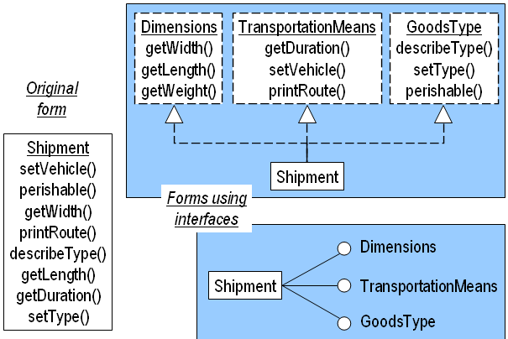
Example

Slide 13
Interfaces to Packages
Interface to package is different idea than an interface to a class
Two ways:
  Provide an interface for a designated object of a class in the package
  - Or -
  Define a class in a package and define its interface as static methods

Slide 14
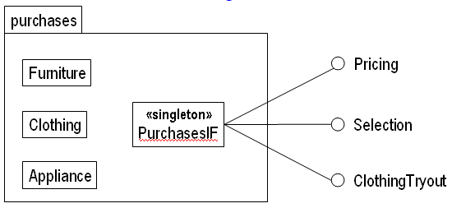
Example 1

Slide 15
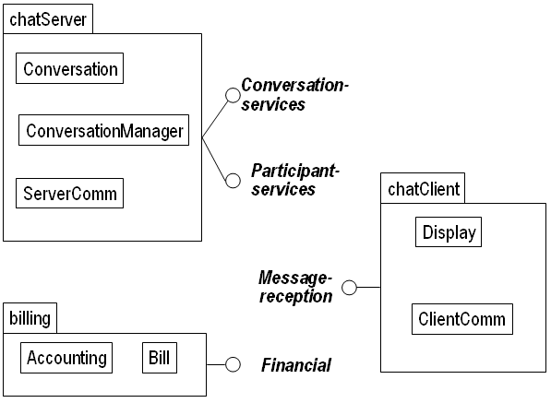
Example 2

Slide 16
Modularization
To modularize an object-oriented application
  Create packages at the higher level
  Create classes at the lower level
Choosing classes: Two general kinds of classes
  Domain classes: classes that pertain to the specific application under design.
    Examples: BankCustomer, BankTransaction, Teller
  Non-domain classes: generic
    Examples: abstract classes, utility classes
    Arise from design and implementation considerations

Slide 17
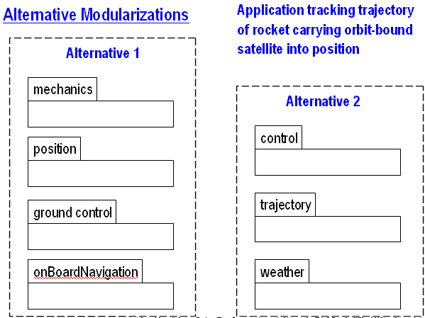
Modularization (Cont’d)
Choosing packages
  Essential part of choosing an application’s architecture
  Decompose application into a set of packages (typically 3 to 10)

Slide 18
Refactoring for Correctness and Sufficiency
Refactoring: revising the design and implementation to accommodate additional requirements
  Extreme programming

Slide 19
Refactoring for Correctness and Sufficiency (Cont’d)
Possible refactoring methods:
  Promoting a primitive attribute to class
    Class selection is the process of identifying a useful concept and defining a class for it
    To accommodate increased scope, refactoring will be needed
    Example: Automobile and mileage
  Introducing abstract classes or interfaces
    Use abstraction when the application contains several classes having significant commonality.

Slide 20
Robustness
Robustness --- ability to handle anomalous situations even in the presence of errors
Sources of error:
  Faulty input
    User input
    Input, not from users
      Data communication
      Function calls made by other applications
  Developer errors
    Faulty design
    Faulty implementation

Slide 21
Verifying Input
(Ensuring Environmental Robustness)
Check all inputs for constraints.
It can include:
  Type verification
  Preconditions
  Invariants
  Postconditions
Initializing variables and objects at declaration/creation time improve robustness

Slide 22
Parameter Passing Techniques to Improve Robustness
Ensure that methods are called safely.
Example:
int computeArea( int aLength, int aBreadth ) { … }
Specify all parameter constraints in method comments
aLength > 0 and aBreadth > 0 and aLength >= aBreadth
Callers obey explicit requirements on parameters
  Problem is that method programmers have no control over callers
Check constraints first within the method code
if( aLength <= 0 ) ……
  Throw exception if this is a predictable occurrence
  Otherwise abort if possible
  Otherwise return default if it makes sense in context, and generate warning or log to a file

Slide 23
Capturing Parameters in a Class
A good way to handle recurring constraints on parameters is to capture (wrap) the parameters in a class
Example:
Replace int computeArea(int aLength, int aBreadth)
{…}
With int computeArea(Rectangle aRectangle)
{…}
--where class Rectangle
    { …
    Rectangle(int aLength, int aBreadth)
    { if(aLength > 0) this.length = aLength;
    else …..
    }
    … }

Slide 24
Design Details
How much is enough?
Most detailed design provide
  Class, sequence, state, and activity models
Provide activity diagram or pseudocode for complex methods only
Code before design?
  Depends on the nature of the task and the experience of the programmer.

Slide 25
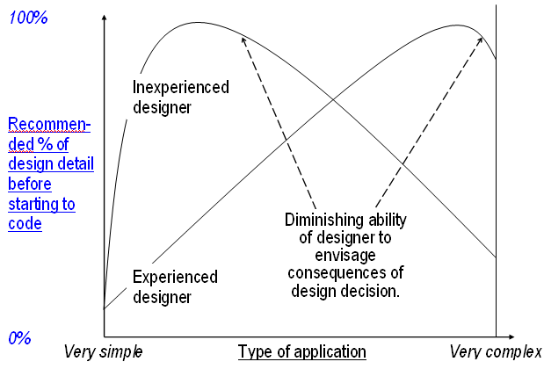
How Much Design Detail Before Initial Coding?

Slide 26
Summary
Correctness of a Design or Code
  Supports the requirements
  In general, many correct designs exist
Robustness of a Design or Code
  Absorbs errors
    Of the user
    Of developers

